Slide 1
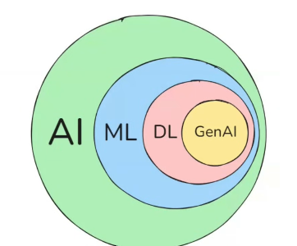

π
Transfomer Model
July 2025
π

Slide 2
π
Index
Transformer Architecture
Component of Deep Learning
Notes:
Content: https://www.linkedin.com/pulse/chunking-strategies-ai-data-kash-kashyap-0lghe/

Slide 3
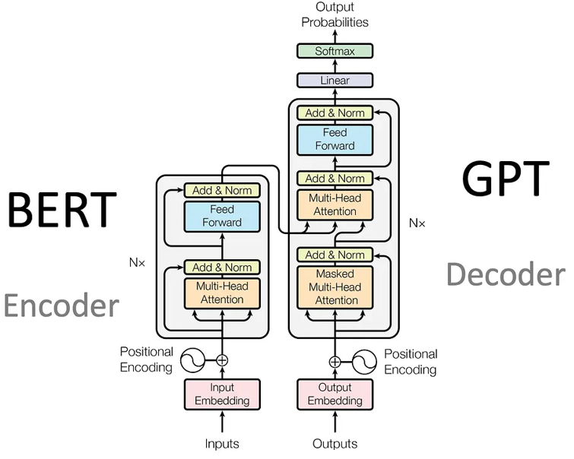
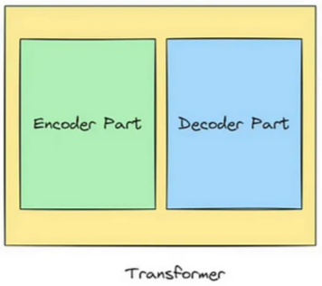
π
Transformer Architecture
key thing to remember to understand Trans..
Self Attention
Multi head Attention
Masked Multi Head Attention
Cross Attention
Position Embedding
Layered Normalizations
Notes:
Content: https://www.linkedin.com/pulse/chunking-strategies-ai-data-kash-kashyap-0lghe/

Slide 4
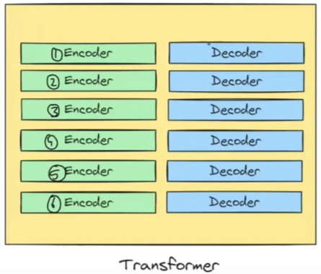
π
Notes:
Content: https://www.linkedin.com/pulse/chunking-strategies-ai-data-kash-kashyap-0lghe/

Slide 5
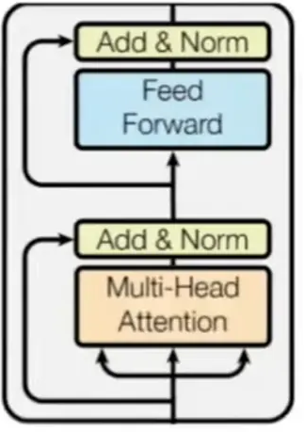
π
Feed Forward NN
Encoder
Self Attention
Each encoder block consists of two main components: a self-attention block and a feed-forward neural network.
The Cat Sat on the Mat
Notes:
Content: https://www.linkedin.com/pulse/chunking-strategies-ai-data-kash-kashyap-0lghe/

Slide 6
π
https://pub.towardsai.net/transformer-architecture-part-1-d157b54315e6
Notes:
Content: https://www.linkedin.com/pulse/chunking-strategies-ai-data-kash-kashyap-0lghe/

Slide 7
π
Notes:
Content: https://www.linkedin.com/pulse/chunking-strategies-ai-data-kash-kashyap-0lghe/

Slide 8
π
Notes:
Content: https://www.linkedin.com/pulse/chunking-strategies-ai-data-kash-kashyap-0lghe/

Slide 9
π
Notes:
Content: https://www.linkedin.com/pulse/chunking-strategies-ai-data-kash-kashyap-0lghe/

Slide 10
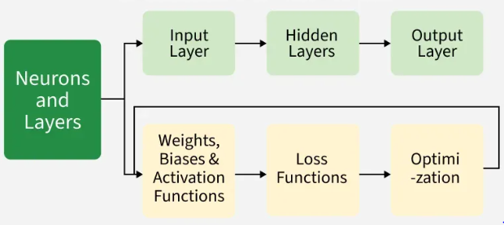
π
Component of Deep learning
Notes:
Content: https://www.linkedin.com/pulse/chunking-strategies-ai-data-kash-kashyap-0lghe/

Slide 11
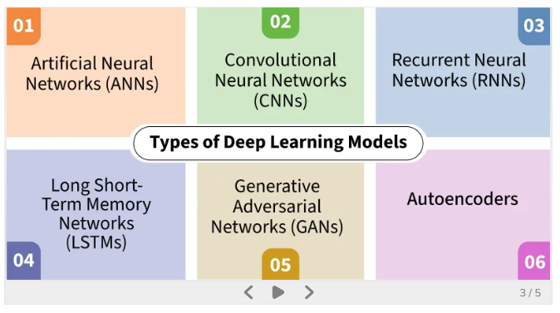
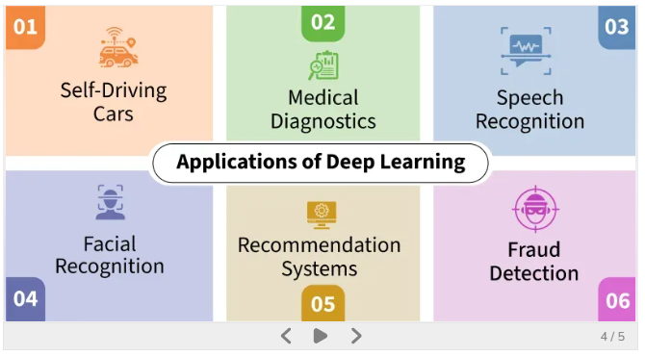
π
Types of Deep Learning Models
Notes:
Content: https://www.linkedin.com/pulse/chunking-strategies-ai-data-kash-kashyap-0lghe/

Slide 12
π
Notes:
Content: https://www.linkedin.com/pulse/chunking-strategies-ai-data-kash-kashyap-0lghe/

Slide 13
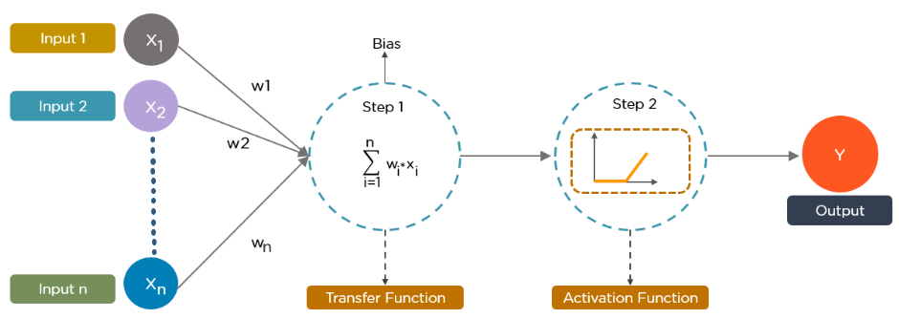
π
Data provides each node with information in the form of inputs. The node multiplies the inputs with random weights, calculates them, and adds a bias. Finally, nonlinear functions, also known as activation functions, are applied to determine which neuron to fire.
Notes:
Content: https://www.linkedin.com/pulse/chunking-strategies-ai-data-kash-kashyap-0lghe/

Slide 14
π
Notes:
Content: https://www.linkedin.com/pulse/chunking-strategies-ai-data-kash-kashyap-0lghe/

